Slide 1
Exscind: Fast Pattern Matching for Intrusion Detection Using Exclusion and Inclusion Filters
Next Generation Web Services Practices (NWeSP)
2011 7th International Conference
Author: Monther Aldwairi, Duaa Alansari
Presenter: Cheng-Feng Ke
Date: 2017/12/20
Department of Computer Science and Information Engineering
National Cheng Kung University, Taiwan R.O.C.
Notes:
1

Slide 2
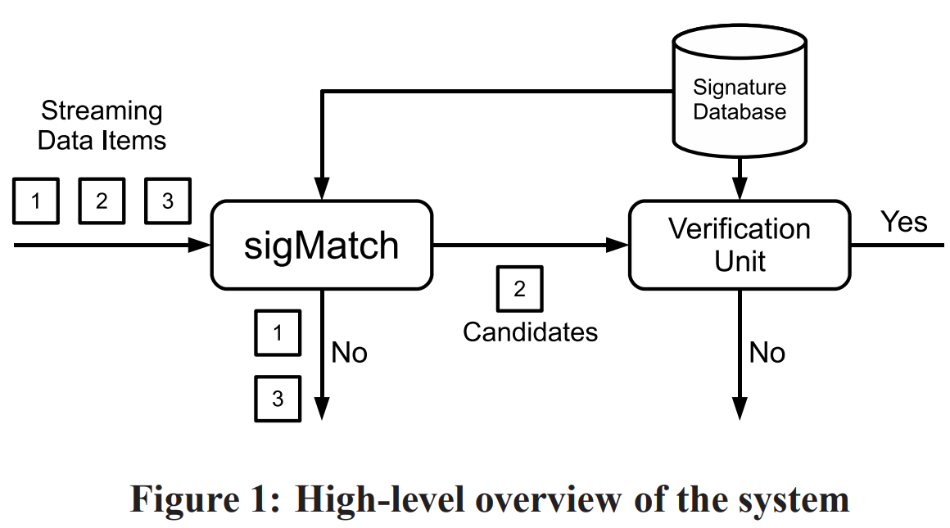
Exscind
Packets
Bloom
Filter
Wu-Manber
A part of Packet Payload
No-Match Packets

Slide 3
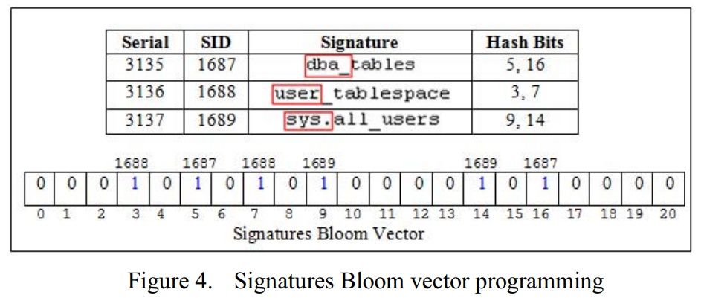
INTRODUCTION

Slide 4
Probable Match Modified WM
PWM rewrites the original WM C++ code [21] using C#.NET in order to support all signature elements especially the HEX bytes between the pipes. PWM extends WM to support all special, control and non-printable ASCII characters as well as the NULL character.
It searches the packet for just the highly probable signatures starting from a certain index provided by the filter.

Slide 5
Evaluation
The experiments are designed to compare Exscind with the regular Wu-Manber algorithm used in Snort.
The simulations are performed on a PC with a 3 GHz Intel Core 2 processor, with 4 GB of main memory running Microsoft Windows 7.
Each experiment is performed 20 times and then average time and memory are scored.

Slide 6
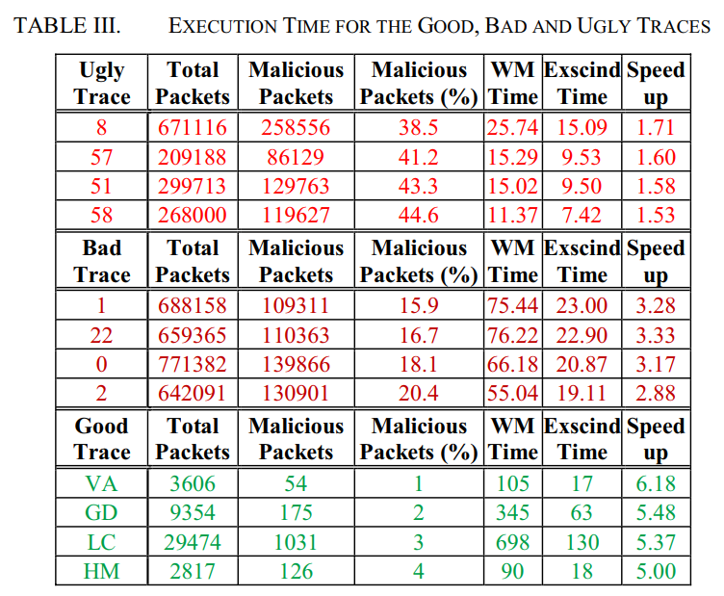
Evaluation
1) SIP_Eyebeam2Eyebeam_Video_Audio (VA) is a video and audio streaming from TechTraces repository [25].
2) Good-Download (GD) is a file download from Laura's Lab Kit v.8 repository [26].
3) Live-Chat (LC) is a live chat application from [26].
4) WebHotmail (HM) is a mail trace from TkuIM mail repository [27].

Slide 7
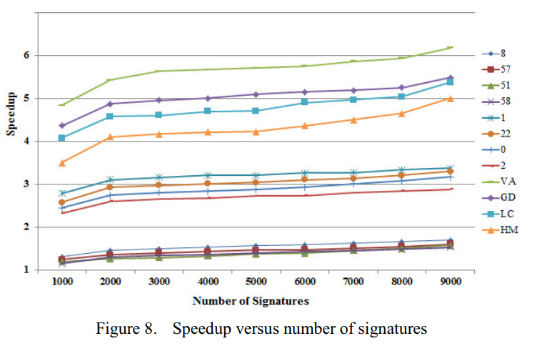
Evaluation
The longer strings penalize the WM which has to perform matching every time while Exscind benefits more from skipping such long strings. Therefore, WM runtime increases while Exscind time gets shorter which explains the slight increase in speedup as the number of signatures increase.
The important conclusion out this experiment is that the speed up achieved by the algorithm is nearly independent from the number of strings if they were completely even in size.

Slide 8
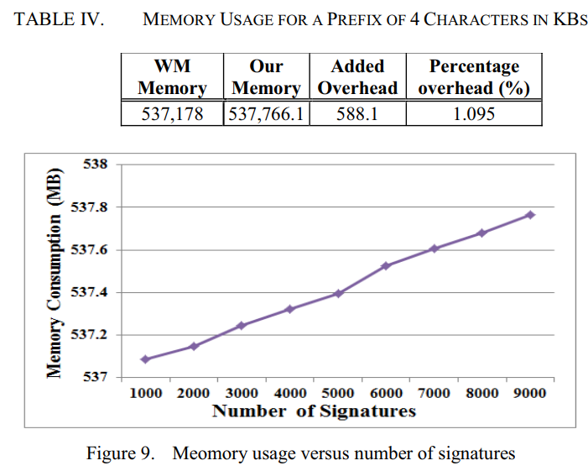
Evaluation
Fig. 9 shows Exscind worst case memory usage measured for the ugly traces versus increasing number of signatures. The memory usage increases linearly with the number of signatures. This is typical of WM based algorithms as opposed to exponential in AC.

